Slide 1
TRIBHUVAN UNIVERSITY • INSTITUTE OF FORESTRY
M.Sc. Forestry | Quantitative Methods & Forest Biometrics
Unit II: Programming Fundamentals in R
Vectorization, Control Flow, Defensive Programming, and Systematic Debugging for Forest Inventory
terminal
MODULE OVERVIEW
Course Module
Unit II: Programming Fundamentals
Academic Program: M.Sc. Forestry
Institution: Tribhuvan University
Focus: Biometric computation in R
menu_book
KEY TOPICS COVERED
Syllabus Pillars
Atomic Vector Types & Coercion
Vectorized Logic vs. Scalar 'if'
Unit Conversions & Defensive Guards
Modular Functions & Tidy Standards
military_tech
CORE COMPETENCIES
Learning Outcomes
Eliminate silent calculation bugs
Automate 5,000+ stem inventories
Master 6-step systematic debugging
Build production forestry scripts
Notes:
Introduce Unit II. Emphasize that programming in forestry is not about writing software, but creating reproducible mathematical calculations that prevent silent numerical corruption.

Slide 2
Tribhuvan University • M.Sc. Forestry • Unit II
Programming Fundamentals in R: Vectors, Conditionals, & Error Handling
Moving from single pocket-calculator stem calculations to full-stand vectorized automation.
analytics
Single Stem BA
BENCHMARK
0.0633
m²
Baseline calculation for individual tree basal area.
dataset
Vectorized Inventory
DATA SCALE
5,000+
Tree Rows
Full-stand automated memory processing.
bug_report
Debugging Protocol
WORKFLOW
6 Steps
Systematic
Structured error isolation and resolution framework.
verified_user
Defensive Code Guard
TARGET GOAL
0
Manual Fixes
100% automated assertion boundary checking.

Slide 3
DEFENSIVE PROGRAMMING & UNITS
The 100-Fold Unit Trap: Silent Mathematical Corruption
check_circle
CORRECT DIAMETER (CM)
VALID BASELINE
0.0633 m²
Formula: BA = pi * (28.4)^2 / 40000
Tree DBH = 28.4 cm correctly produces valid basal area of 0.0633 m².
warning
THE MILLIMETER DISASTER
100X MAGNIFICATION TRAP
6.33 m²
Entering DBH = 284 mm into a centimeter formula magnifies basal area by 100x!
A single stem exceeds the area of a large house, skewing total stand biomass.
verified_user
THE AUTOMATED ASSERTION GUARD
DEFENSIVE CODE GUARD
stopifnot()
Code must assert domain bounds before calculation:
if (any(dbh > 400 | dbh < 5)) {
stop('Biological DBH violation!')
}
Catch errors before they corrupt models.
Notes:
Discuss how silent unit errors are the most dangerous in forestry because scripts run to completion without error messages.

Slide 4
R EXECUTION ARCHITECTURE
Vectorized Operations vs. The Scalar 'if' Trap in R
❌ SCALAR 'IF' STATEMENT
Length-1 Check Only
Syntax: if (dbh > 30) { ... }
• In R, standard 'if' evaluates ONLY the first tree in the vector!
• Subsequent 4,999 trees are completely ignored without warning.
• Causes silent bias and false logical decisions across entire plots.
✅ VECTORIZED ASSERTIONS
ifelse() & any() / all()
Syntax: ifelse(dbh > 30, 'Canopy', 'Understory')
• Evaluates all 5,000 tree stems simultaneously.
• Uses SIMD-style vector primitives for 100x faster execution.
• Use 'any(is.na(dbh))' or 'all(dbh > 0)' for stand-wide logical audits.
Notes:
Contrast R's vectorized nature with traditional programming languages like C or Python loops.

Slide 5
DATA STRUCTURES IN R
Forest Inventory Data Types: Preventing Type Coercion
NUMERIC (DOUBLE)
Examples:
DBH (cm), Total Height (m), Basal Area per Tree (m²)
Rule:
Continuous real measurements. Never enter commas ('1,200'), which silently coerces numeric columns into character strings.
INTEGER
Examples:
Stem Count, Plot Record ID, Live Tree Tally Number
Rule:
Discrete whole counts (42L). Conserves memory across plots and prevents fractional stems in stand inventory tables.
FACTOR
Examples:
Species Code, Forest Type, Canopy Stratum Class
Rule:
Categorical fixed levels. Enforces taxonomic naming and prevents silent typos (e.g., 'Shorea' vs 'shorea').
LOGICAL
Examples:
Is_Alive, Has_Rotten_Core, Crown_Sampled Flag
Rule:
Boolean TRUE / FALSE flags. Enforces binary conditions; enables rapid vector filtering: inventory[Is_Alive, ].
Notes:
Review how factors enforce valid taxonomic names and prevent silent typos from creating ghost species.

Slide 6
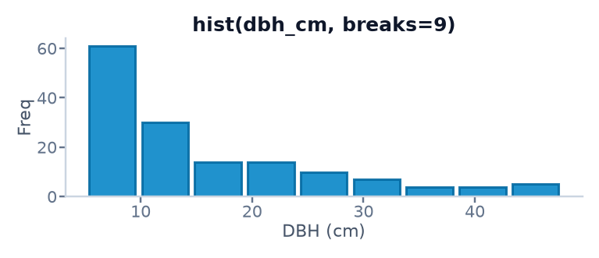
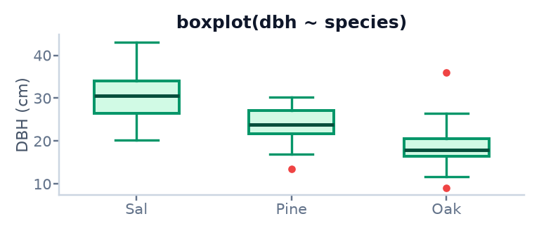
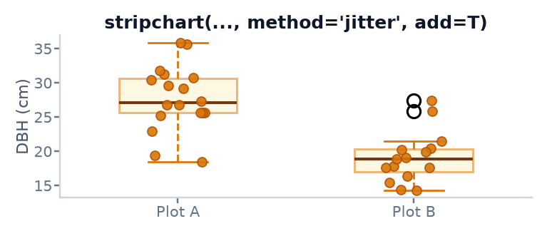
DATA VISUALIZATION IN R • PART I
Core Distribution Plots: hist(), boxplot(), & stripchart()
Selecting the right graph, diagnosing stand structure, and tuning parameters for univariate distributions.
hist(x, ...)
INPUT: 1 Continuous (dbh_cm, height_m)
FORESTRY APPLICATION (WHEN & WHY)
Check stand structure (inverse-J regeneration vs. even-aged bell curve), skewness, and unit anomalies or outliers.
TOP PARAMETERS TO TWEAK IN CLASS
breaks (bin count or break vector)
freq = FALSE (density scale for overlays)
labels = TRUE (print tree counts on bars)
xlim, ylim, col (axis bounds & bar styling)
boxplot(formula, ...)
INPUT: 1 Continuous ~ 1 Categorical (dbh ~ species)
FORESTRY APPLICATION (WHEN & WHY)
Compare medians, 25th–75th percentile spread (IQR), symmetry, and outliers across species, plots, or forest stands.
TOP PARAMETERS TO TWEAK IN CLASS
horizontal = TRUE (readable species labels)
varwidth = TRUE (box width ∝ √n sample size)
notch = TRUE (median 95% CI comparison)
las = 2, boxwex (vertical labels & width scale)
stripchart(formula, ...)
INPUT: 1 Continuous ~ 1 Categorical (dbh ~ species)
FORESTRY APPLICATION (WHEN & WHY)
Overlay on boxplot() (add = TRUE) when sample size is small (n < 50) so students see the exact trees behind the box summary.
TOP PARAMETERS TO TWEAK IN CLASS
method = "jitter" (prevent point overlap)
jitter = 0.15 (horizontal spread width factor)
pch = 19 (clean solid dot symbol)
add = TRUE, vertical (overlay on active boxplot)

Slide 7
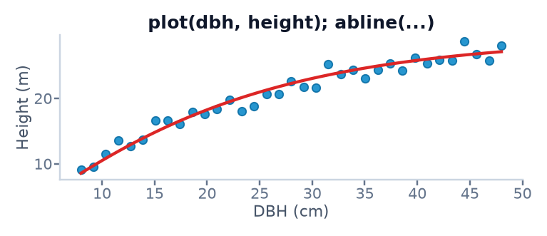
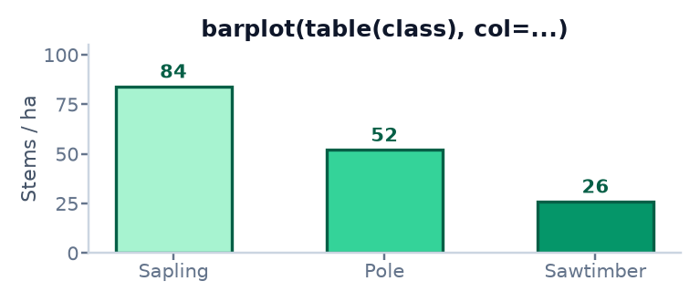
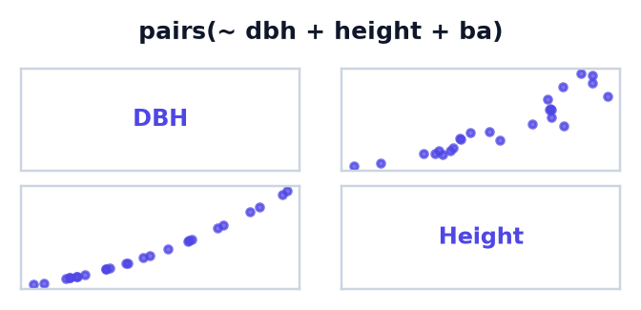
DATA VISUALIZATION IN R • PART II
Relationships & Compositions: plot(), barplot(), & pairs()
Visualizing tree allometry curves, categorical inventory shares, and multi-variable correlation matrices.
plot(x, y, ...)
INPUT: 2 Continuous (dbh_cm, height_m)
FORESTRY APPLICATION (WHEN & WHY)
Inspect height–diameter or biomass allometry, check linearity vs. saturation curves, and spot transcription outliers.
TOP PARAMETERS TO TWEAK IN CLASS
pch = 19, cex (point shape & size scaling)
col, bty = "L" (clean 2-sided axis frame)
abline() (add fitted allometry regression)
lines(), text() (model overlays & annotations)
barplot(height, ...)
INPUT: 1 or 2 Categorical (table(species))
FORESTRY APPLICATION (WHEN & WHY)
Compare stem counts, size-class frequencies (Sapling/Pole/Sawtimber), or species shares across inventory plots.
TOP PARAMETERS TO TWEAK IN CLASS
beside = TRUE (grouped vs. stacked bars)
horiz = TRUE (horizontal bars for long names)
names.arg (custom category label vector)
legend.text, ylim (legend & headroom expansion)
pairs(formula, ...)
INPUT: 3+ Continuous (dbh_cm, height_m, ba_m2)
FORESTRY APPLICATION (WHEN & WHY)
Instant correlation scan across all numeric columns to detect linear vs. power-law scaling (e.g., Basal Area ∝ DBH²).
TOP PARAMETERS TO TWEAK IN CLASS
panel = panel.smooth (spline loess trend fit)
col, pch = 20 (marker transparency & point size)
lower.panel = NULL (drop redundant mirror half)
cex.labels (diagonal variable font size)

Slide 8
SYSTEMATIC CODE TROUBLESHOOTING
The 6-Step Systematic Debugging Protocol
STEP 01
READ
Read the exact error message and call stack without panic.
STEP 02
ISOLATE
Create a minimal reproducible example (reprex) with 3 tree rows.
STEP 03
TYPES
Check variable structures using str() and typeof().
STEP 04
TRACE
Insert print() statements or browser() before the error line.
STEP 05
SOLVE
Apply vectorized fix or boundary guard assertion.
STEP 06
TEST
Run full stand dataset to ensure regression did not occur.
Notes:
Teach students never to guess solutions. Follow the 6-step diagnostic protocol.

Slide 9
MODULAR PROGRAMMING
Encapsulating Forestry Allometry into Reusable Functions
❌ COPY-PASTE SPREAD OF FORMULAS
Duplication Risk
• Copying 'pi * dbh^2 / 40000' across 50 scripts creates severe maintenance debt.
• If the formula is updated (e.g. adding bark deduction), 49 scripts remain broken.
• Violates the DRY (Don't Repeat Yourself) principle.
✅ REUSABLE PARAMETERIZED FUNCTION
calculate_basal_area()
calculate_ba <- function(dbh, unit = 'cm') {
if (unit == 'mm') dbh <- dbh / 10
stopifnot(dbh > 0)
return(pi * dbh^2 / 40000)
}
• Centralizes allometric logic.
• Enforces automatic unit conversion and domain assertion.
Notes:
Demonstrate how packaging equations into custom functions prevents widespread calculation errors.

Slide 10
TABULAR DATA STANDARDS
Tidy Data Principles for Forest Inventory Tables
RULE 1: EACH STEM IS A ROW
Unique Observation
Every single row in the data frame represents exactly one measured tree or plot entity.
Never combine multi-stem clump measurements into one row cell.
RULE 2: EACH ATTRIBUTE IS A COLUMN
Distinct Variable
Plot_ID, Stem_ID, Species, DBH_cm, Height_m, Decay_Class must each occupy distinct columns with explicit data types.
RULE 3: ONE OBSERVATION LEVEL PER TABLE
Relational Integrity
Tree-level measurements belong in tree_data.csv.
Plot-level coordinates and slope belong in plot_metadata.csv.
Joined by Plot_ID key.
Notes:
Explain tidy data principles (Wickham 2014) in the context of forest inventories.

Slide 11
UNIT II SYNTHESIS
Summary: Core Programming Rules for Foresters
DEFENSIVE HABITS
Never Trust Input Data
1. Always inspect column structures with str() and summary().
2. Use vectorized assertions to verify biological boundaries (5 <= DBH <= 350).
3. Avoid scalar 'if' for multi-tree operations.
4. Save custom functions in R/ directory scripts.
THE AUTOMATION PAYOFF
5,000 Stems in 0.02s
By vectorizing calculations:
• 100 forest inventory plots process in milliseconds.
• Human transcription errors are eliminated.
• The entire dataset can be audited by external reviewers instantly.
Notes:
Conclude Unit II and introduce Unit III (Data Cleaning and APIs).

